Slide 1
Acoustic scattering by spheres and swim bladders

Slide 2
Spherical benchmark models

Slide 3
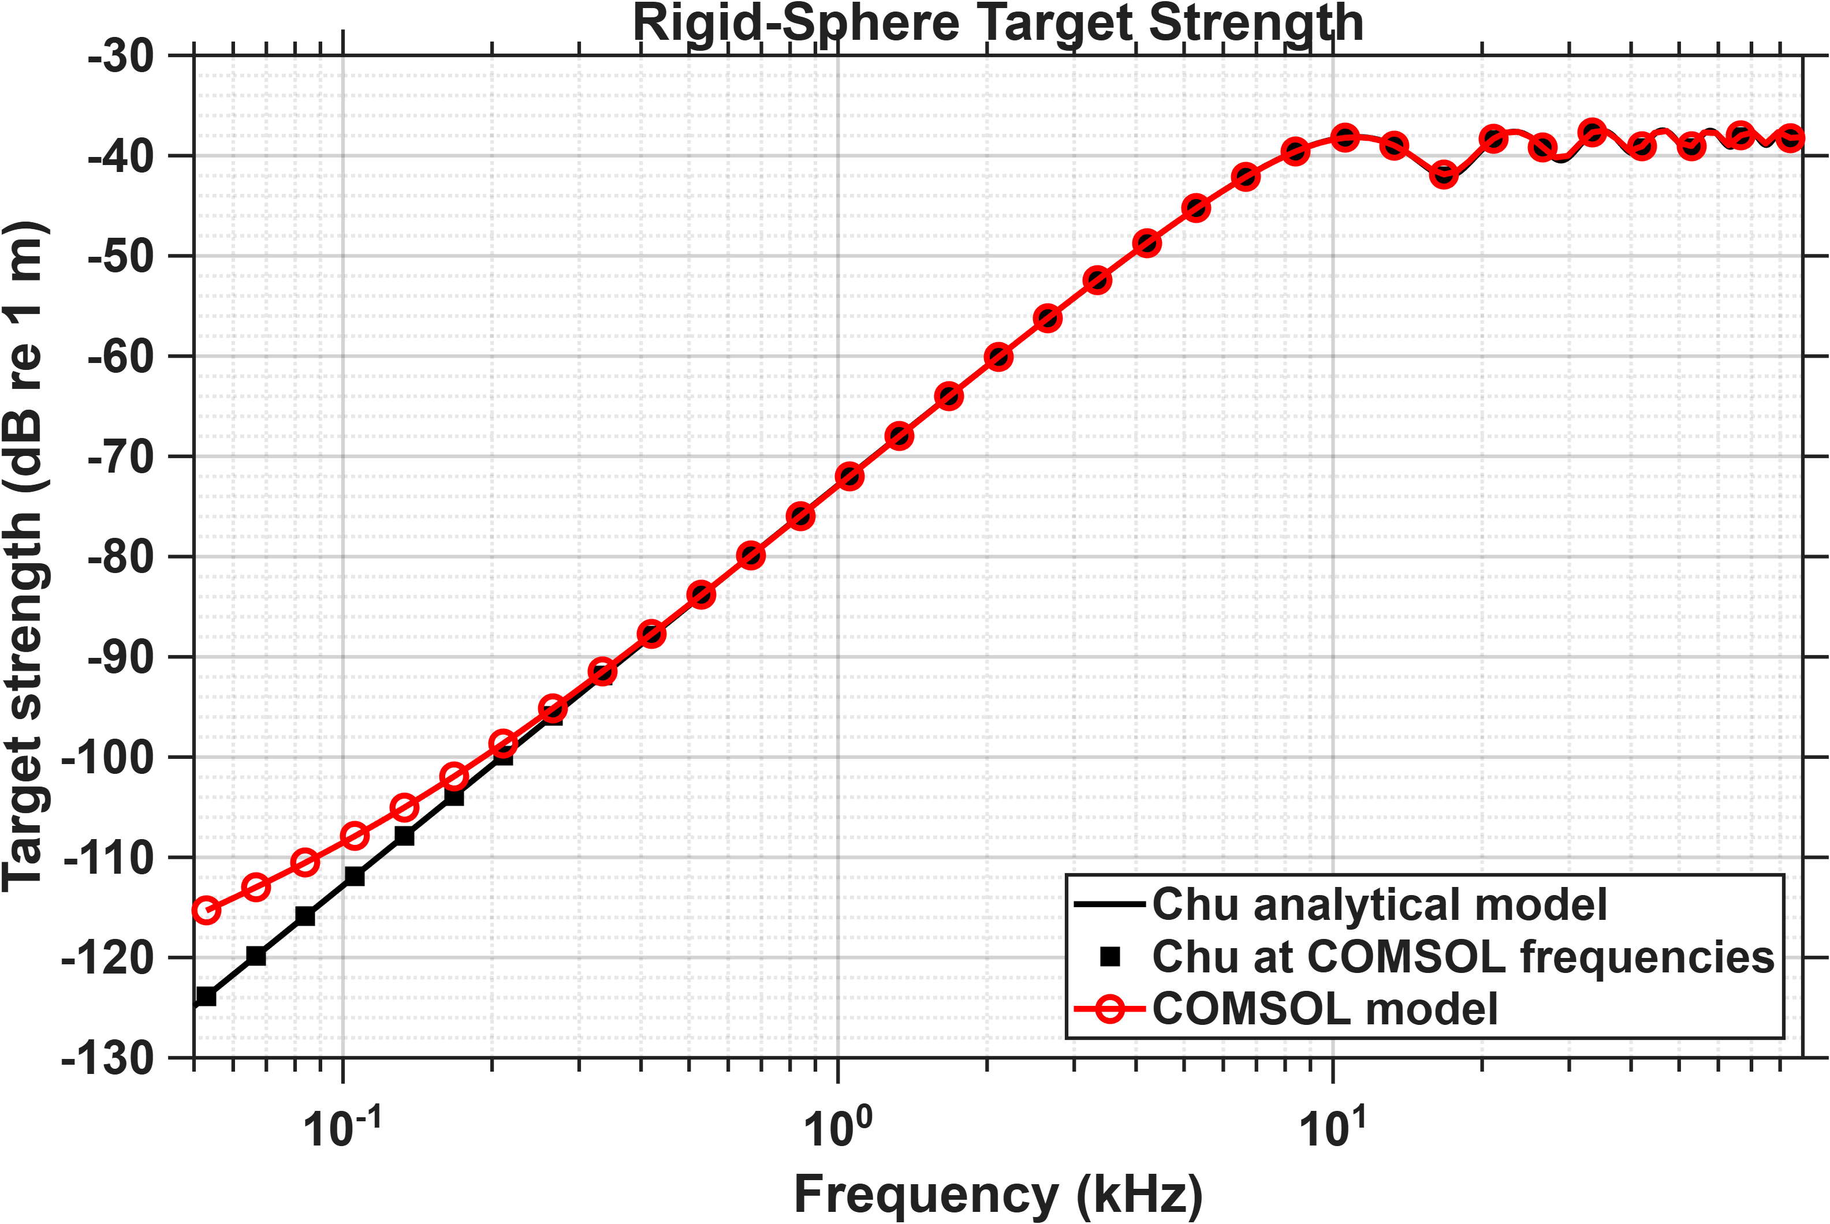
Radius of scatterer: 2.5 cm
Radius of domain: 4.5 cm
PML thickness: 1 cm
Physics-based mesh: Fine

Slide 4
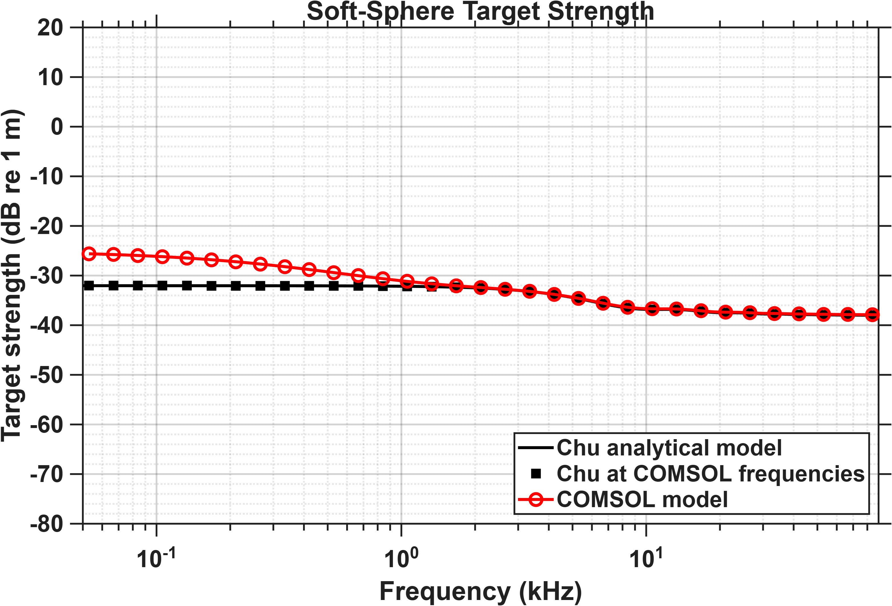
Radius of scatterer: 2.5 cm
Radius of domain: 4.5 cm
PML thickness: 1 cm
Physics-based mesh: Fine

Slide 5
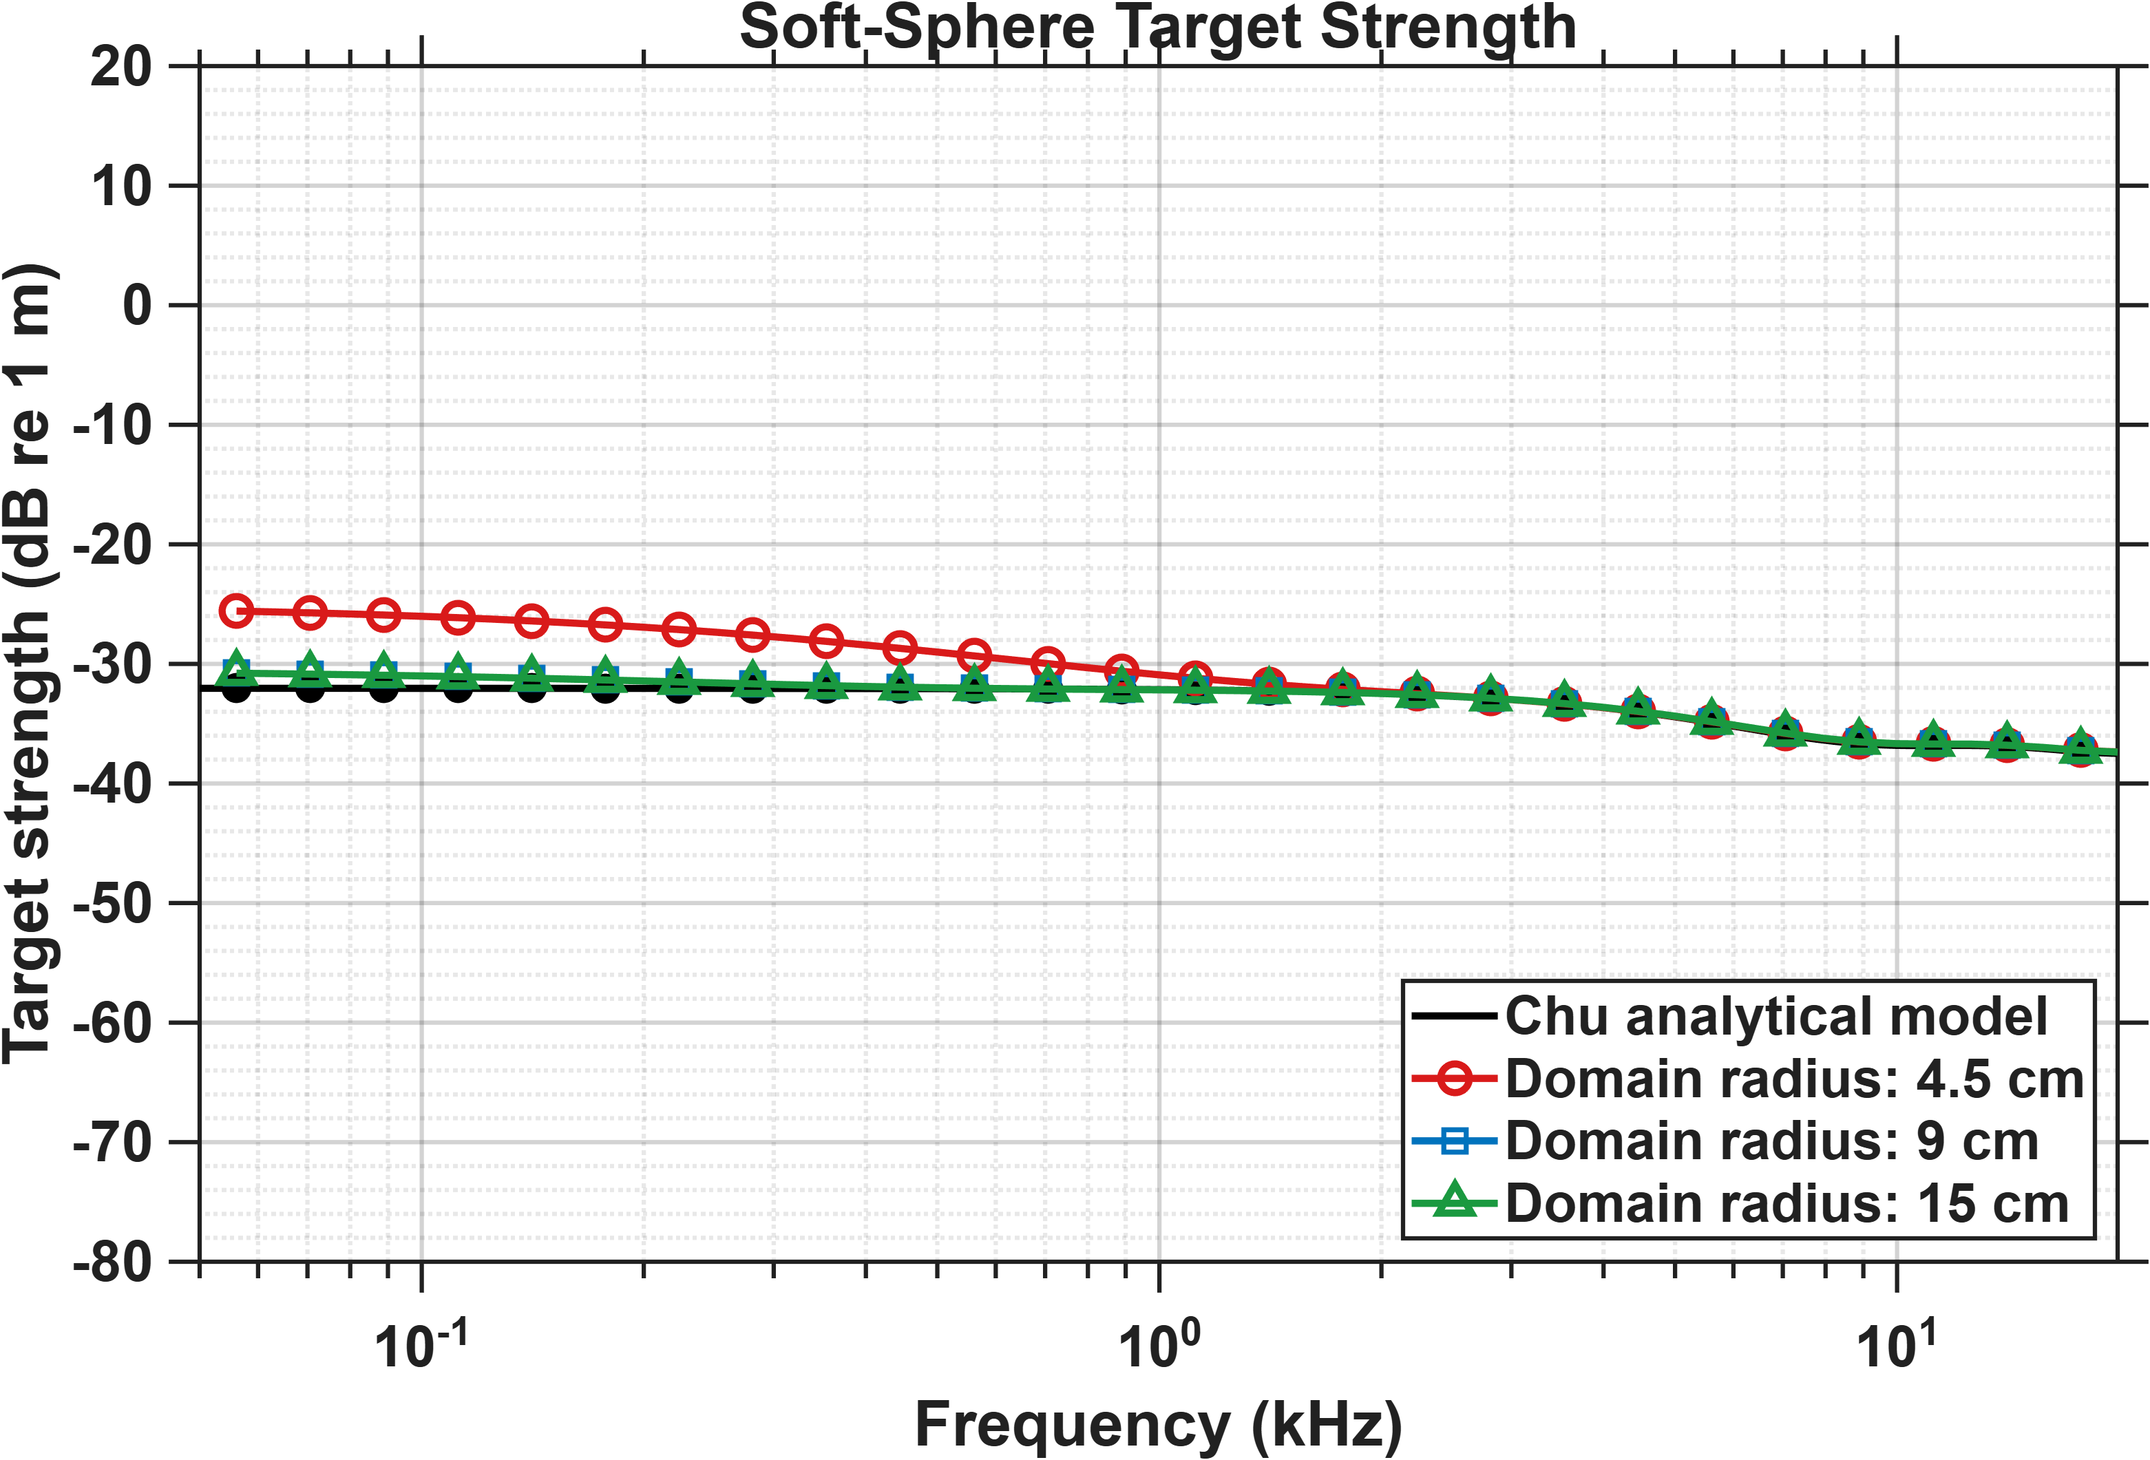
Low frequency mismatches are ‘mostly’ resolved by making the domain size bigger
Note:
The limits on the y-axis are different compared to the previous soft sphere plot to see differences more clearly
These simulations only focus on the low frequency region where the mismatches were

Slide 6
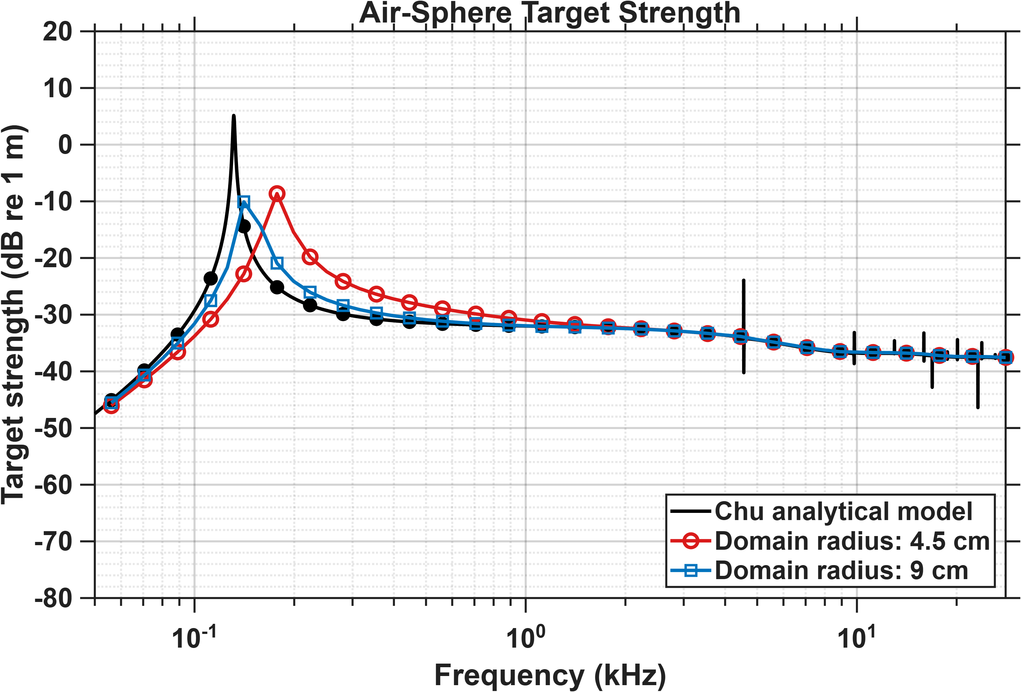
For air sphere mismatch in resonance is also improved by making the domain size bigger.

Slide 7
Fish and swim bladder models

Slide 8
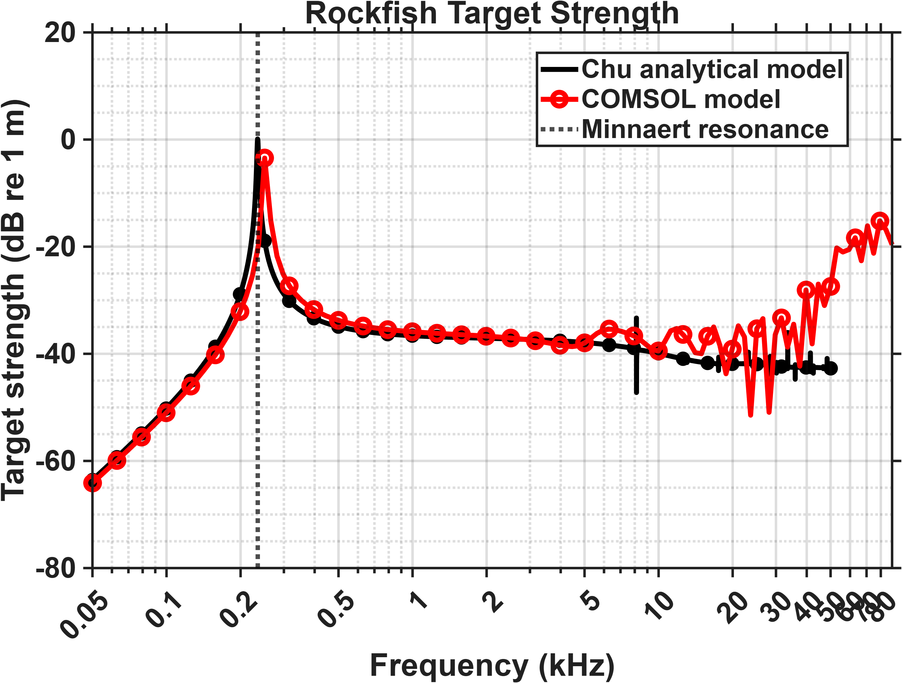
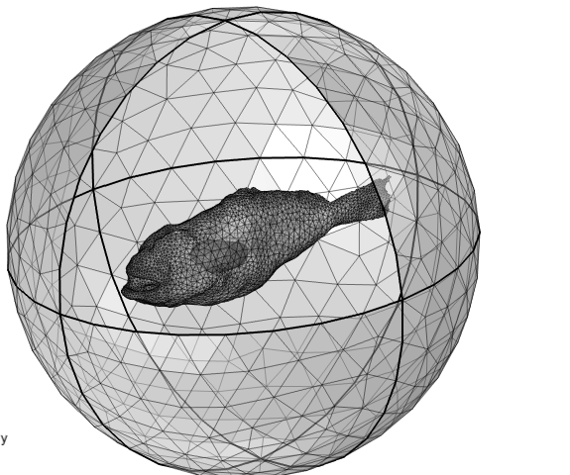
Rockfish: Dorso-ventral incidence
Water domain radius: 15 cm
PML thickness: 2.5 cm
Volume-equivalent spherical radius
of swim bladder: 1.4 cm

Slide 9
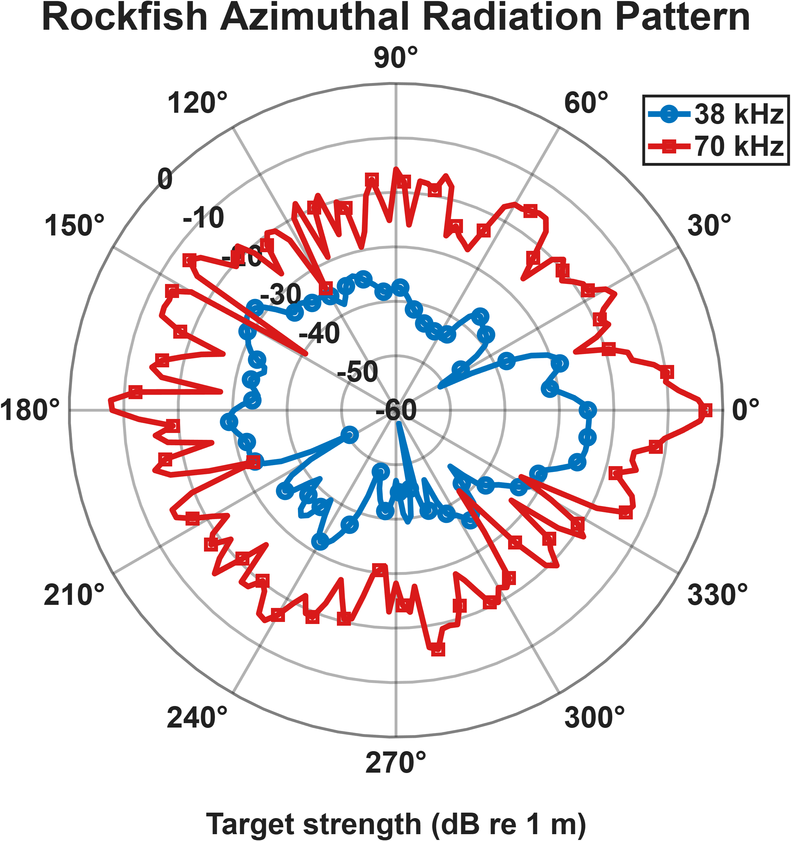
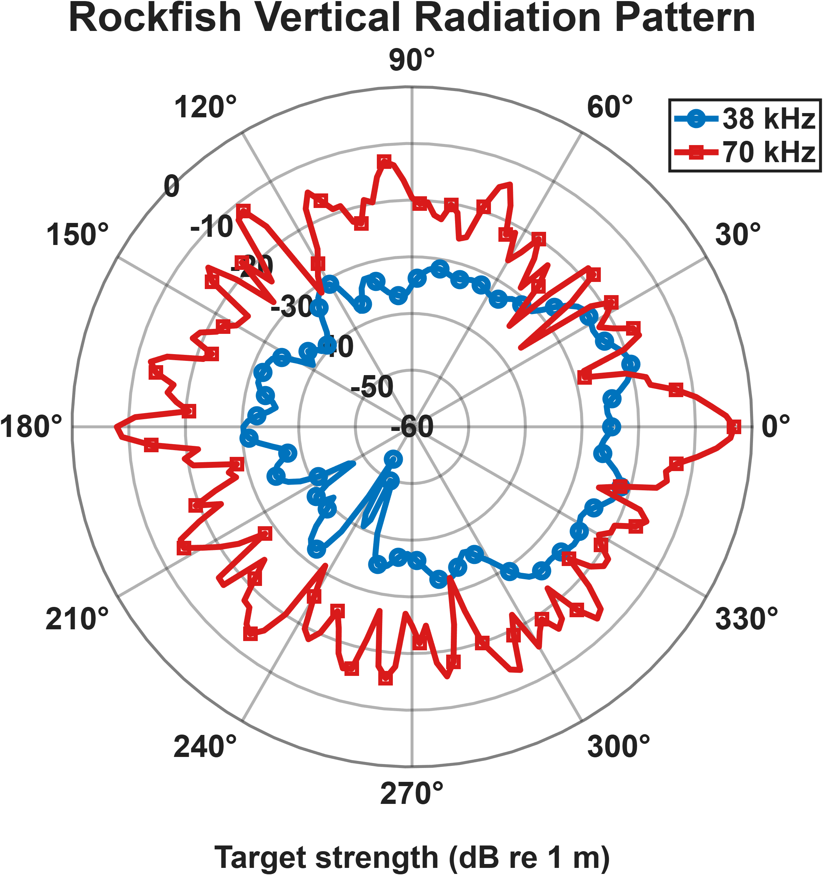
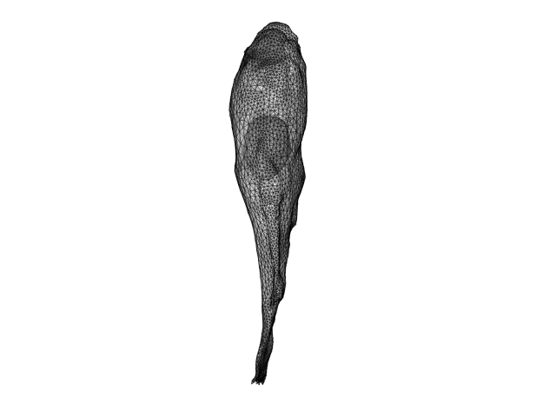

Slide 10
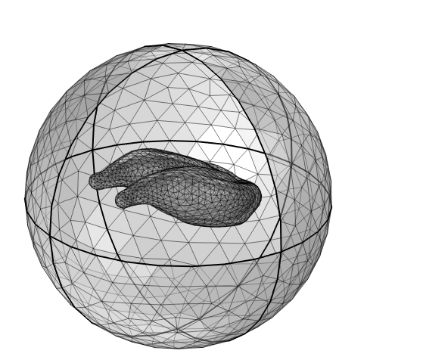
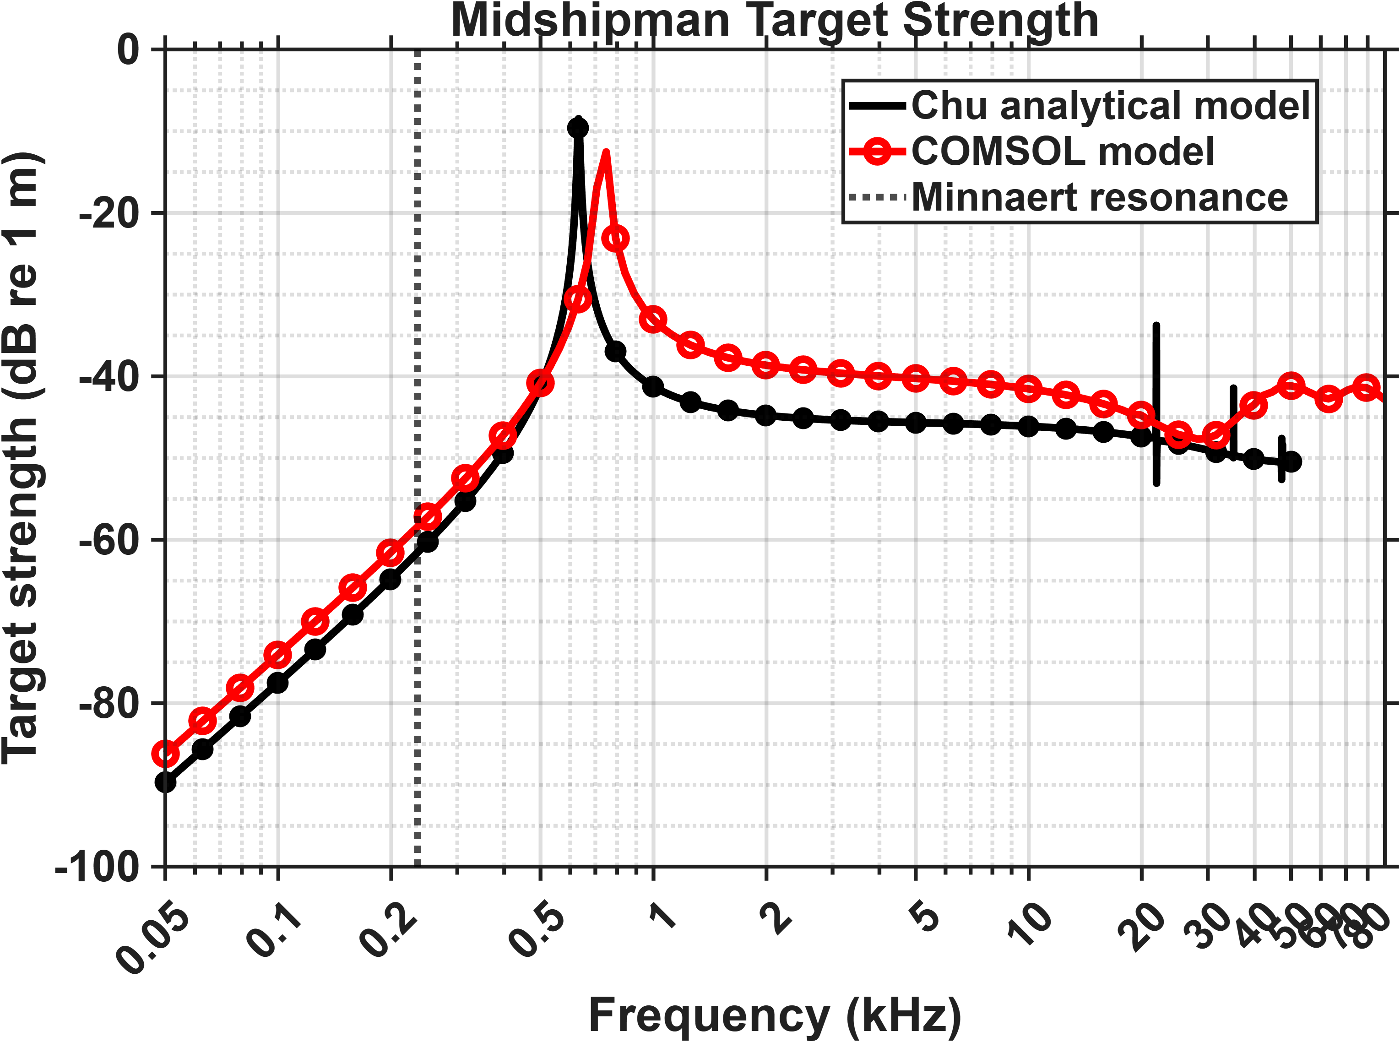
Midshipman: Dorso-ventral incidence
Water domain radius: 2 cm
PML thickness: 0.5 cm
Volume-equivalent spherical radius
of swim bladder: 0.52 cm

Slide 11
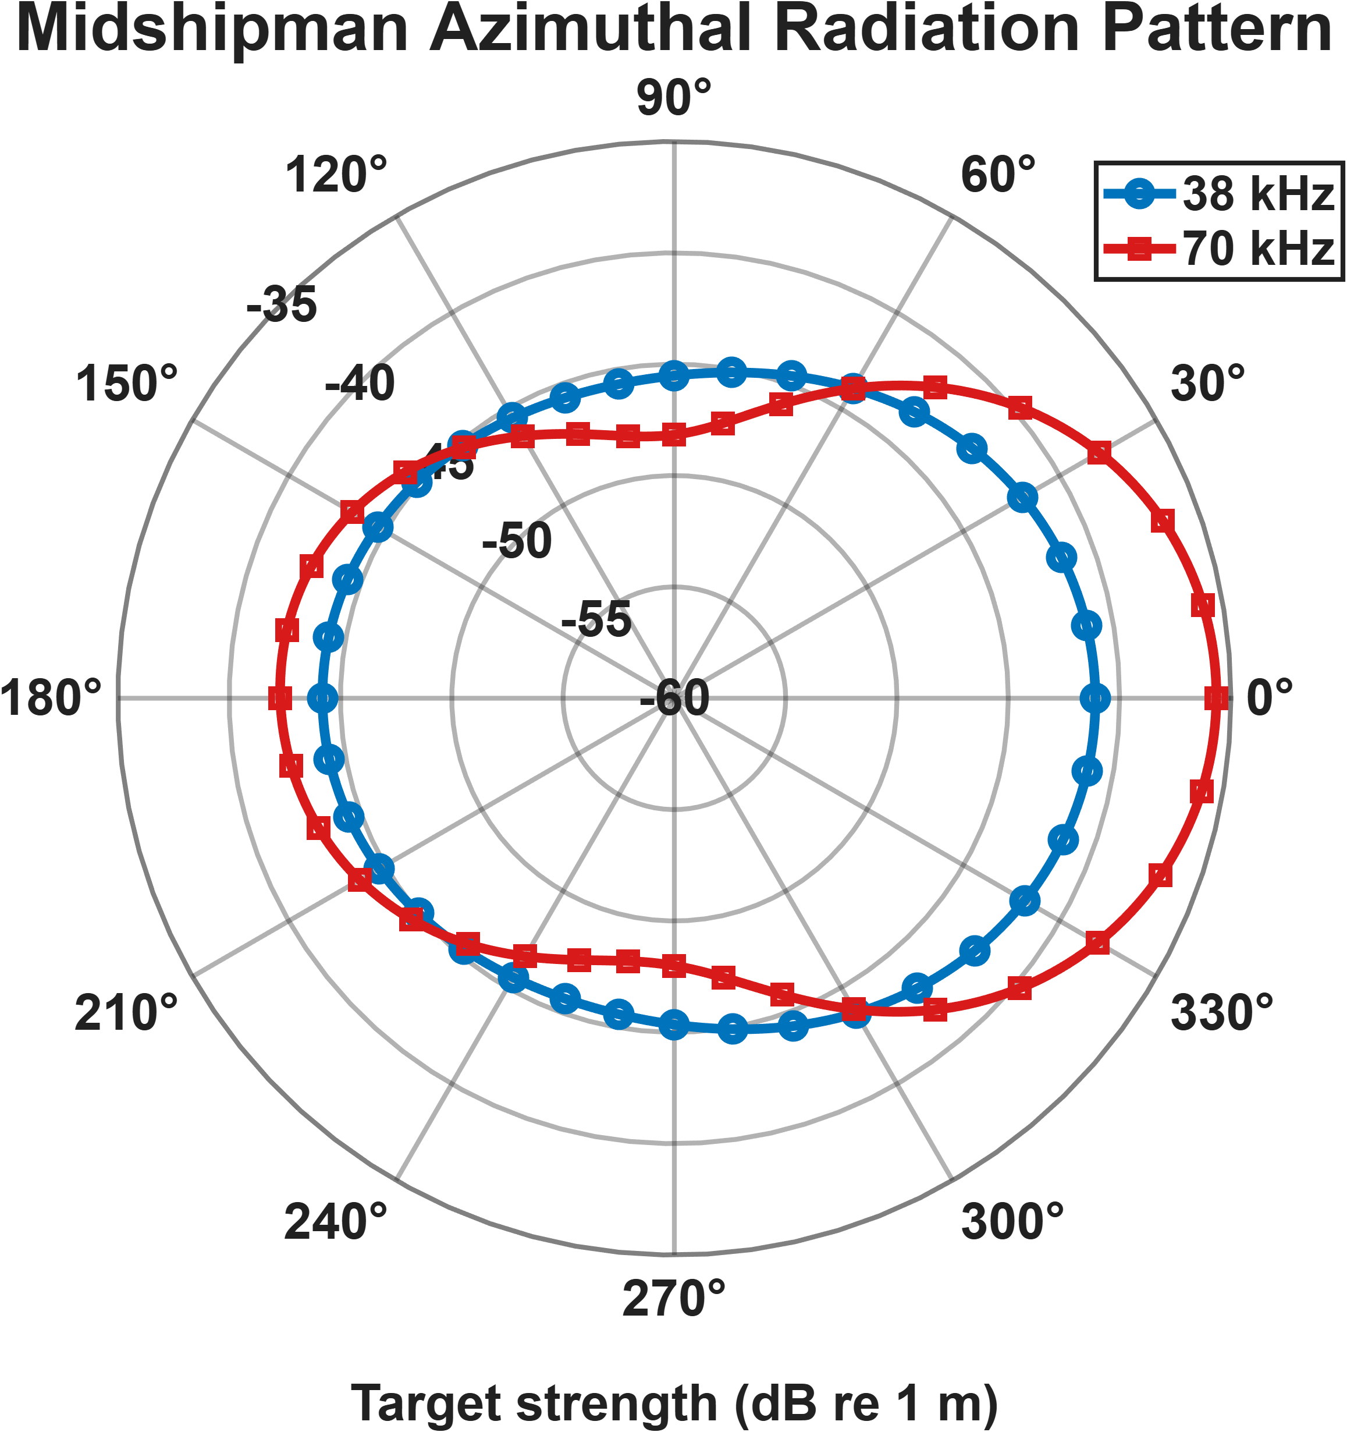
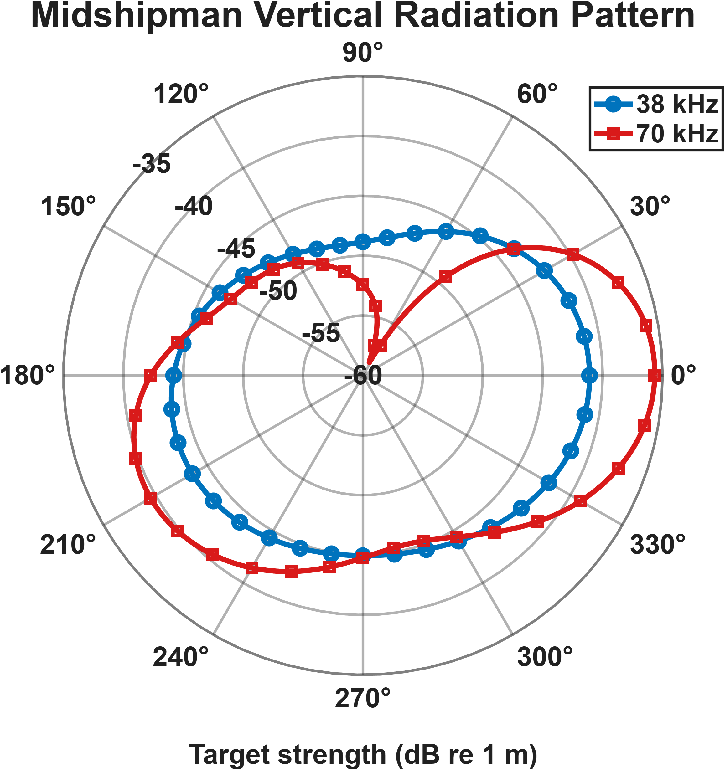
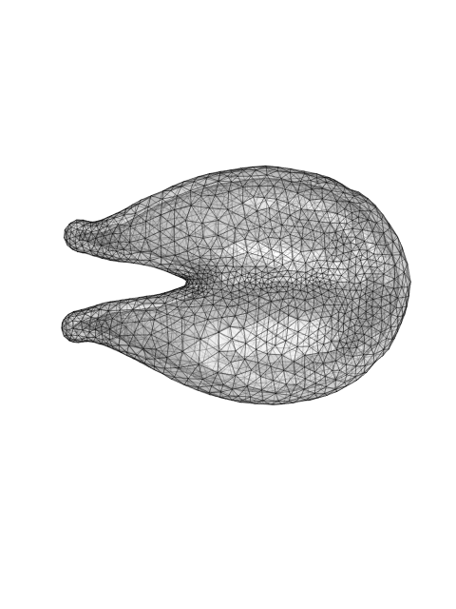

Slide 12
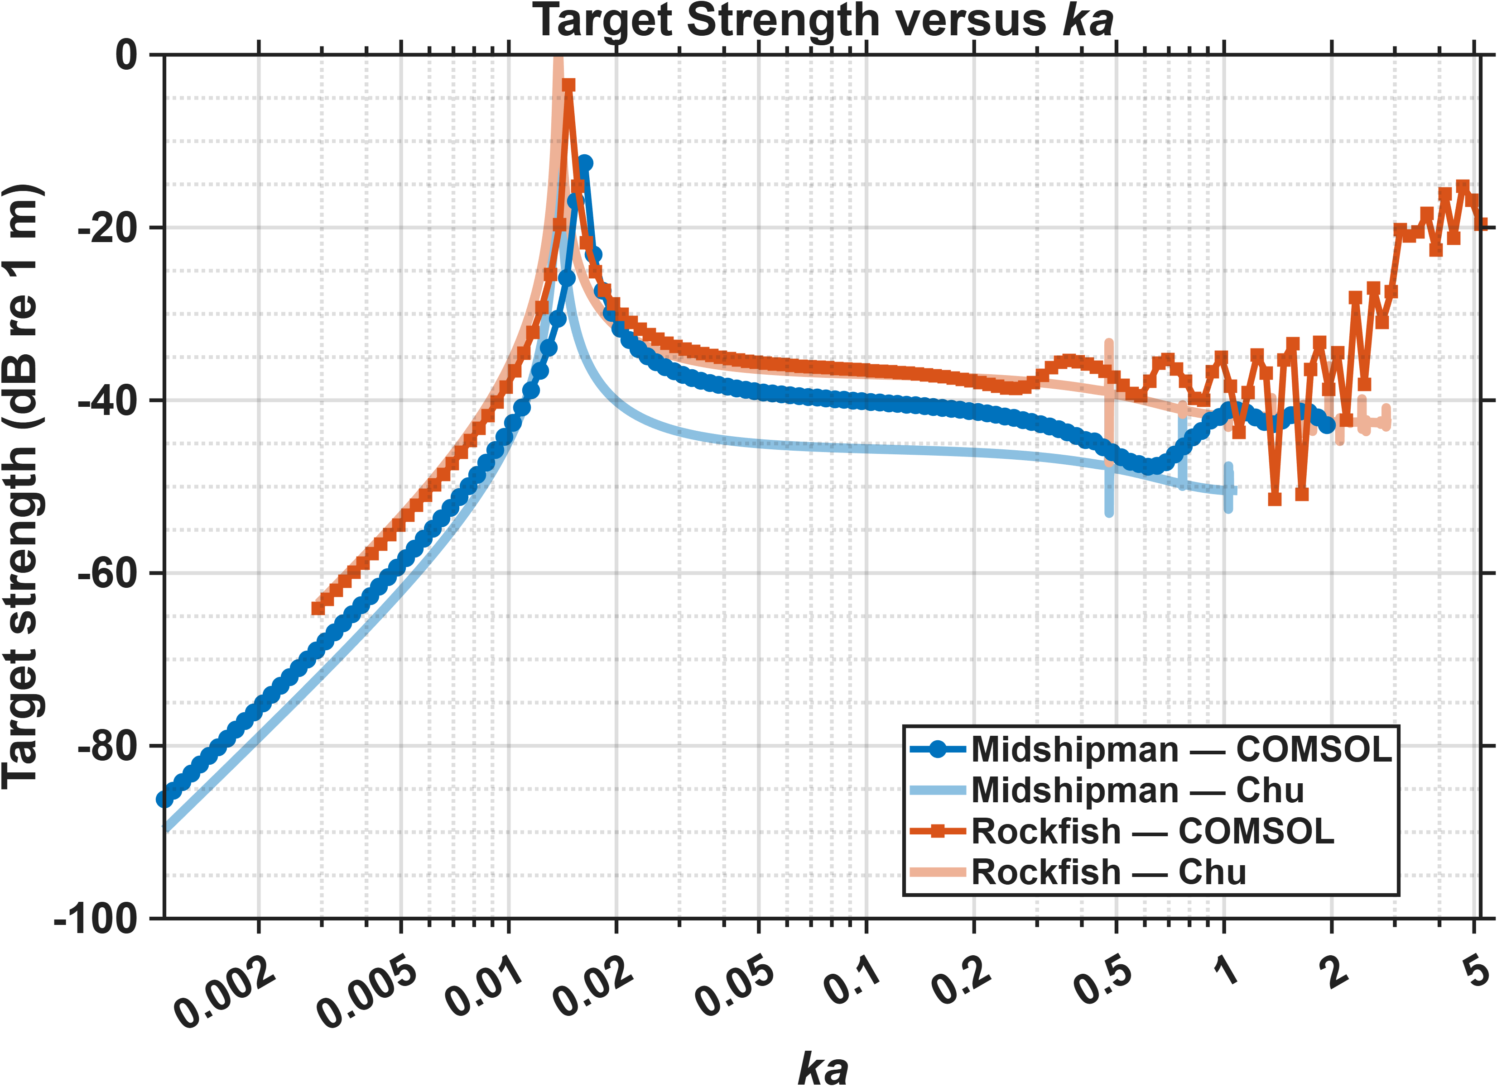
Midshipman-Rockfish dorsoventral incidence

Slide 14
Mesh size comparisons

Slide 15
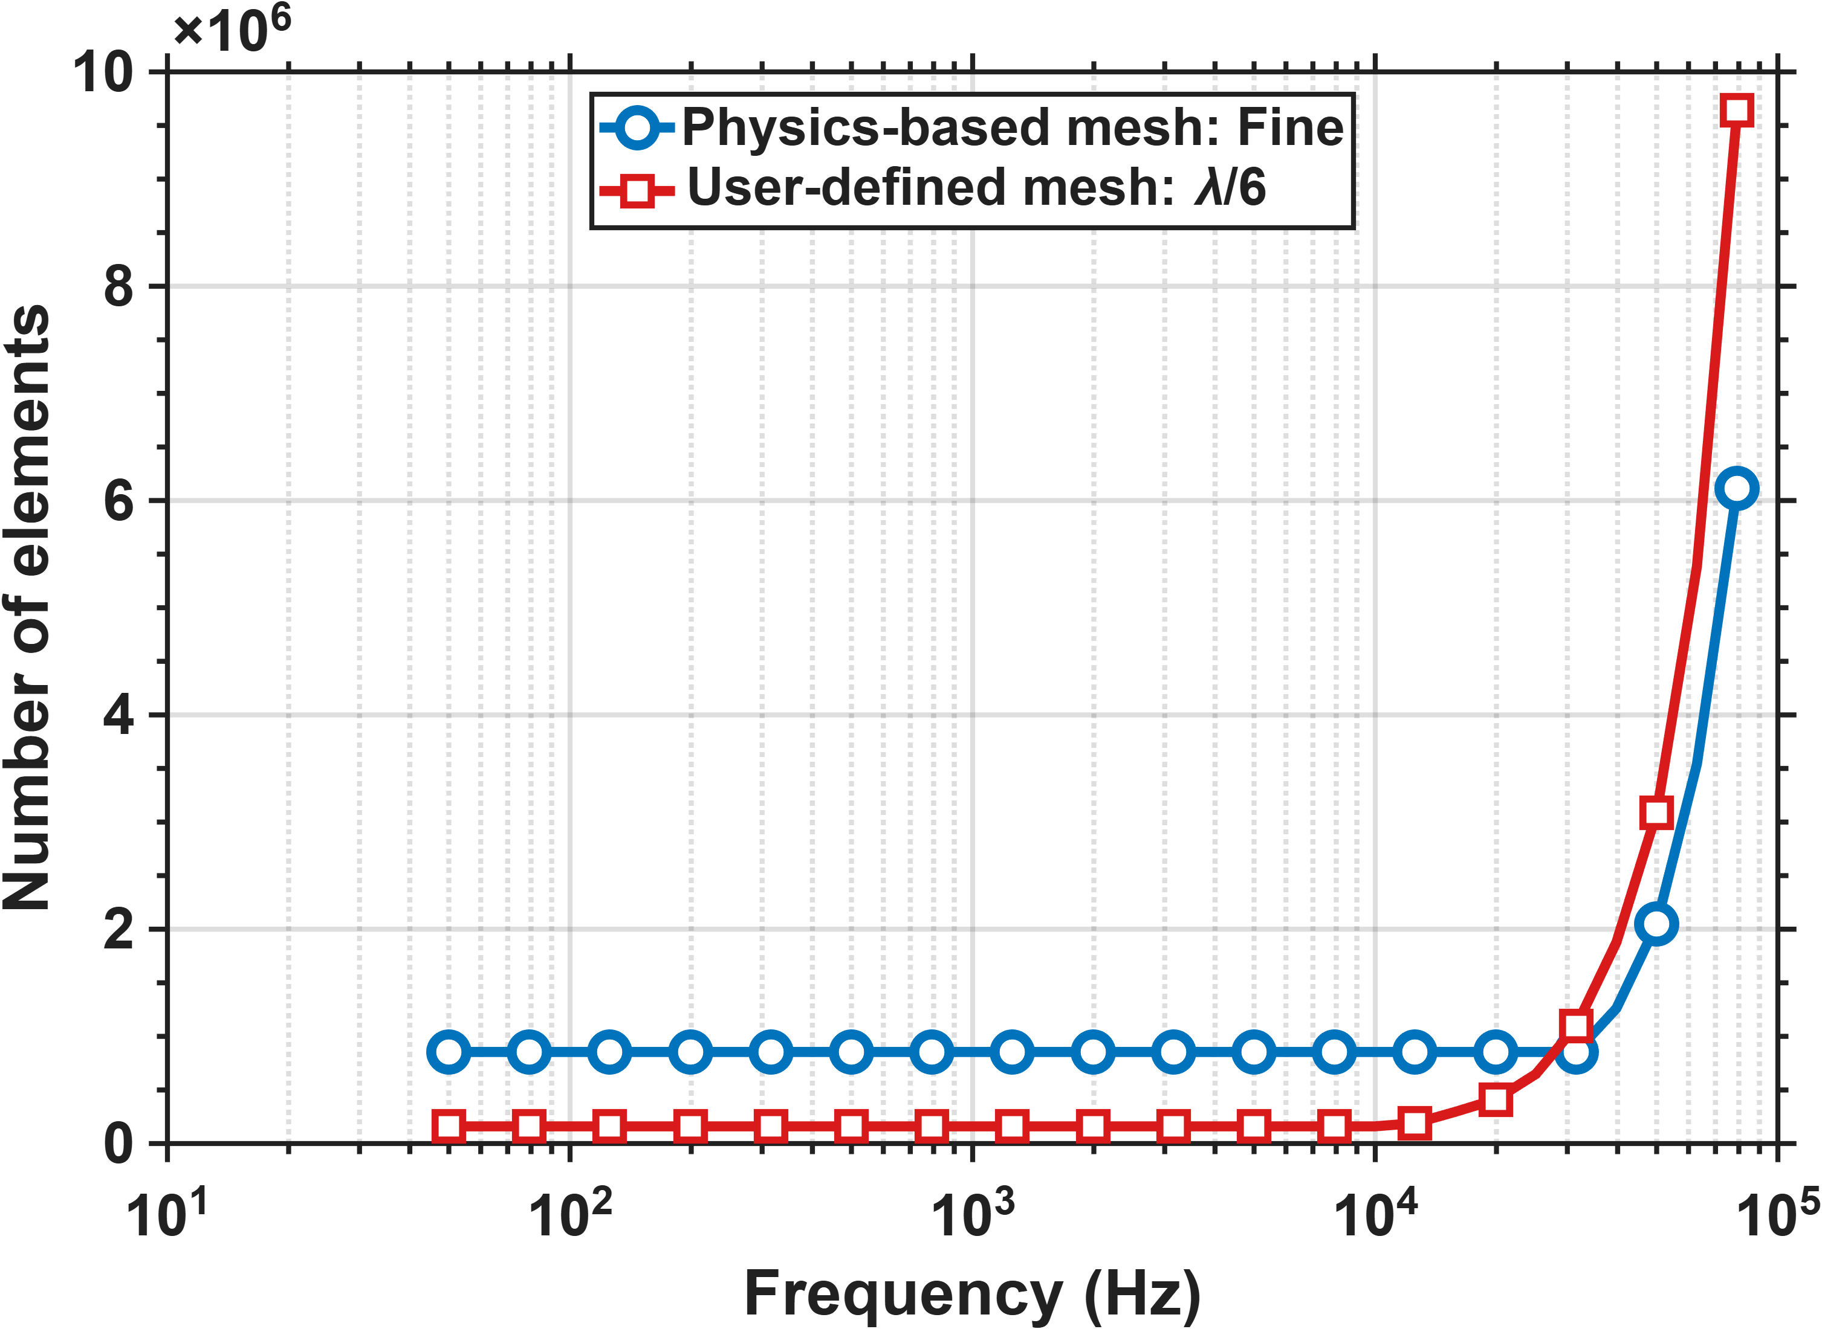
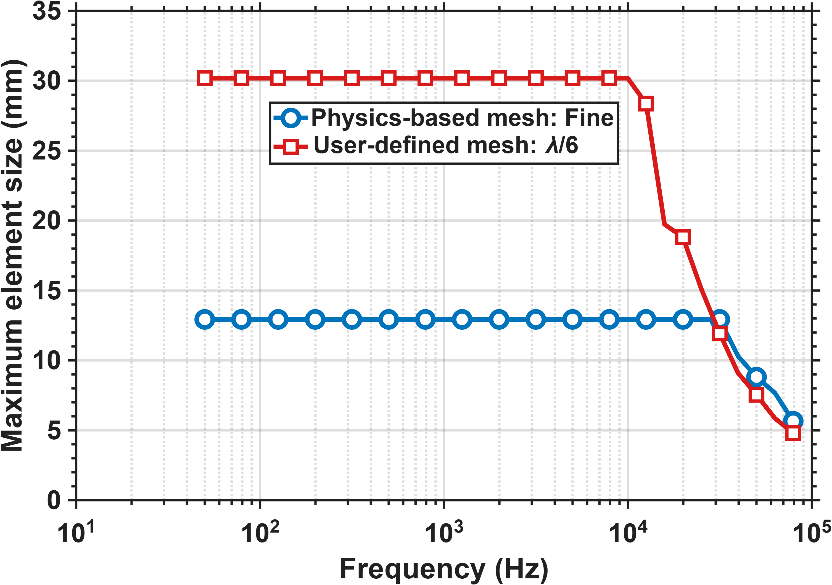
Soft sphere

Slide 16
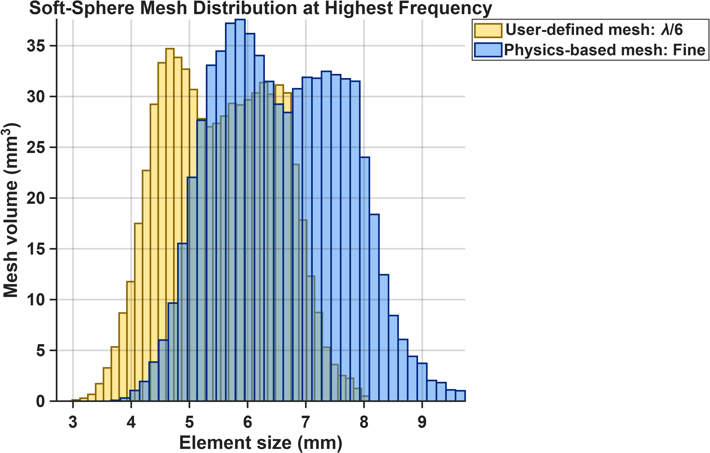
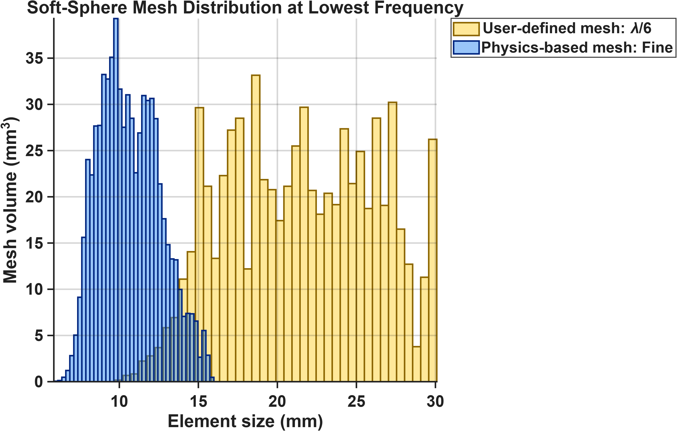
Soft sphere

Slide 17
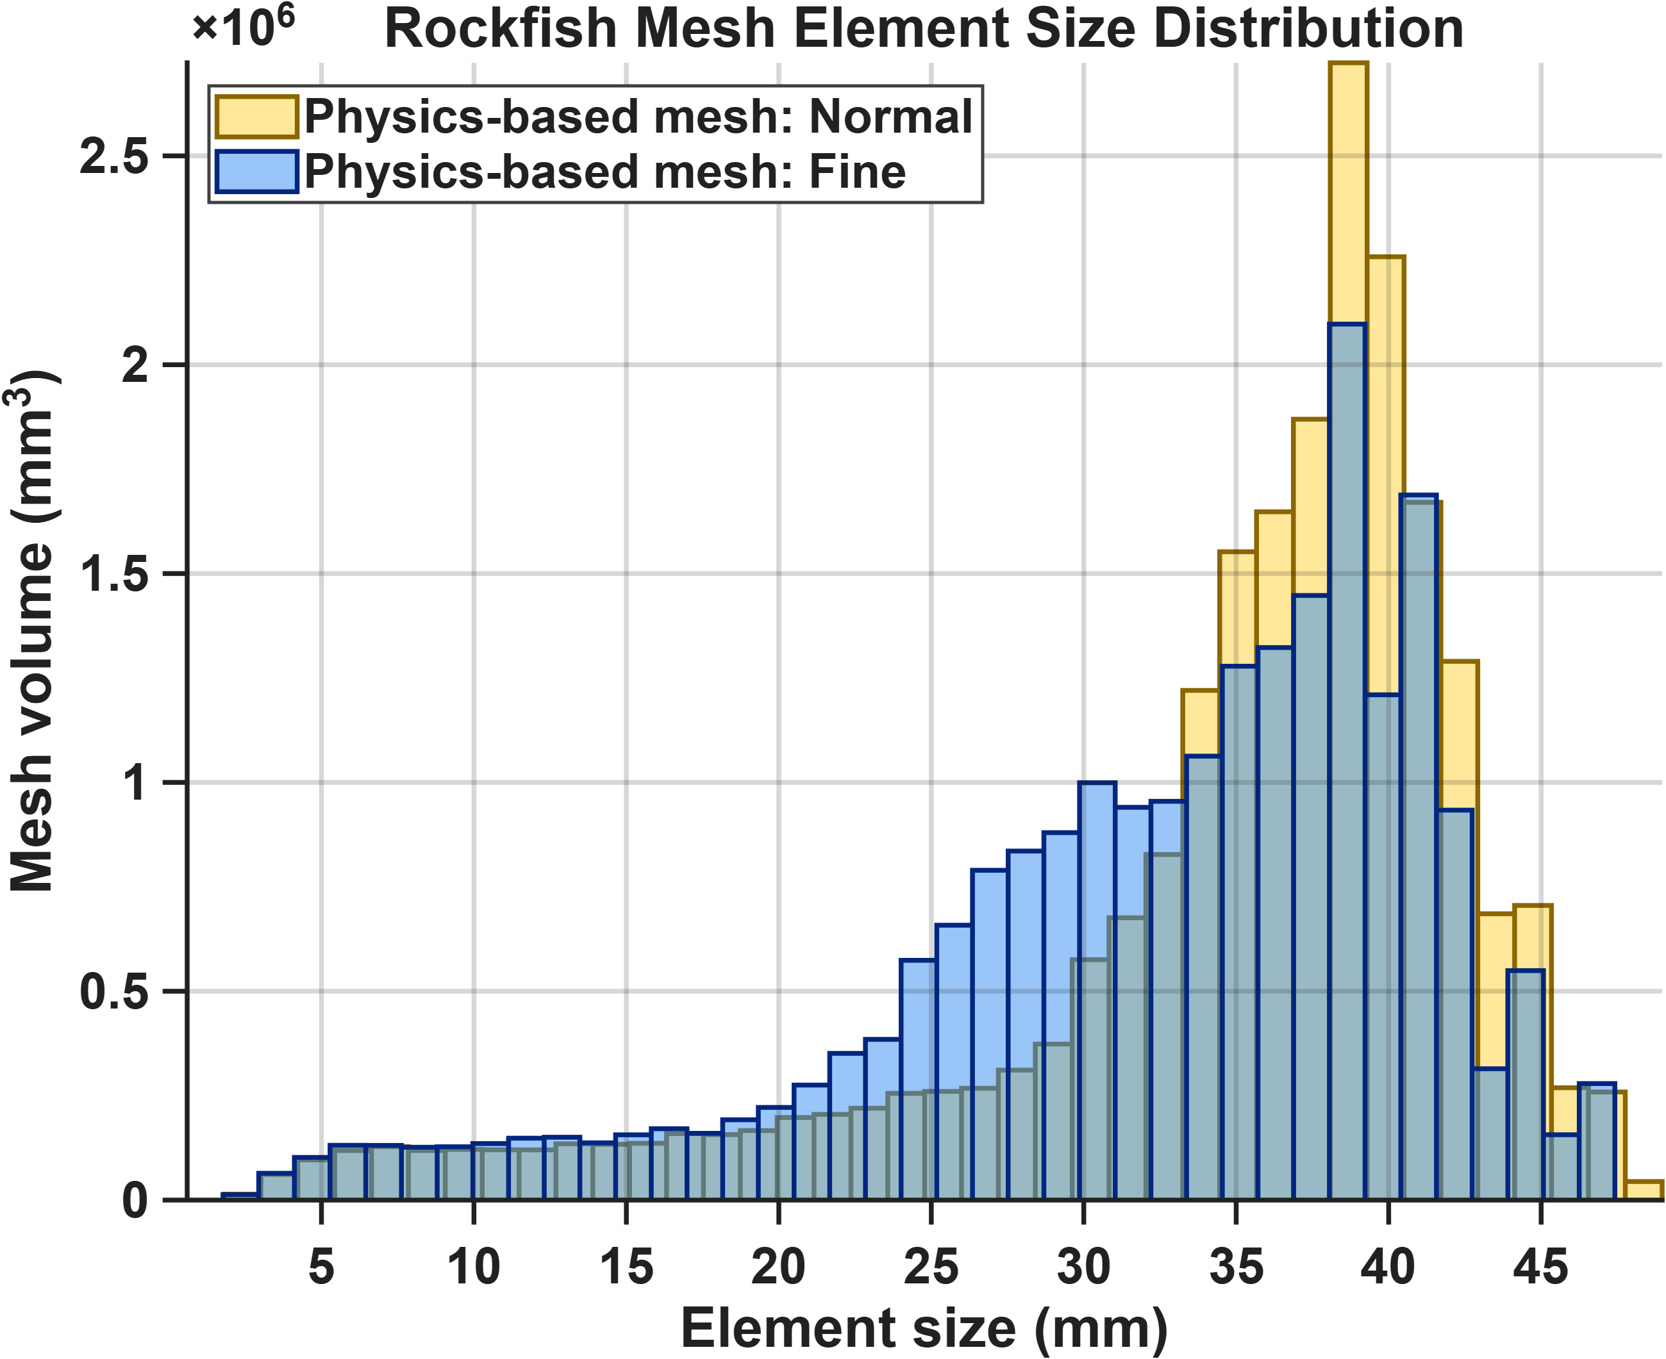
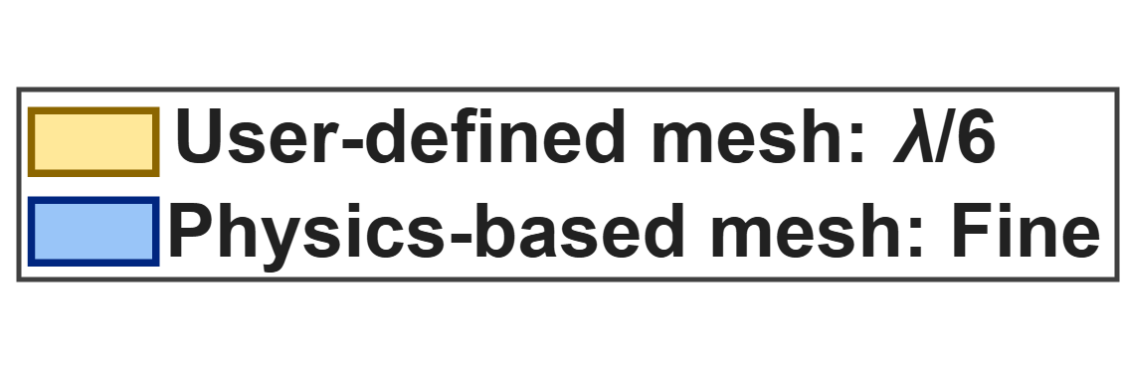
Rockfish
NOTE
These distributions are for the mesh used for the highest frequency in the sweep.
I have not computed user-based mesh statistics for this one yet, but still interesting to see comparisons between fine and normal

